Slide 1
Chapter 27
WWW and HTTP

Slide 2
27-1 ARCHITECTURE
The WWW today is a distributed client/server service, in which a client using a browser can access a service using a server. However, the service provided is distributed over many locations called sites. Each site holds one or more documents, referred to as Web pages. Each Web page, however, can contain some links to other Web pages
in the same or other sites.
27.<number>

Slide 3

Figure 27.1 Architecture of WWW
27.<number>

Slide 4
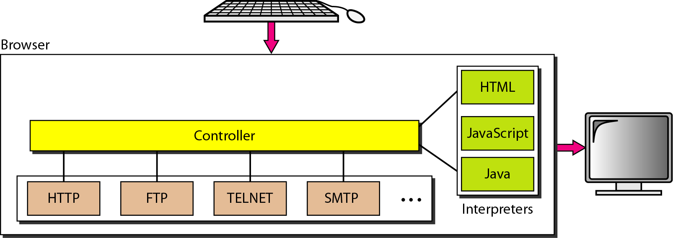
Figure 27.2 Browser
27.<number>

Slide 5
Figure 27.3 URL
27.<number>

Slide 6
The protocol is the client-server application program used to retrieve the document.
Many different protocols can retrieve a document; among them are Gopher, FTP, HTTP, News, and TELNET. The most common today is HTTP.
The host is the domain name of the computer on which the information is located.
The URL can optionally contain the port number of the server.
Path is the pathname of the file where the information is located.
27.<number>

Slide 7
27-2 WEB DOCUMENTS
The documents in the WWW can be grouped into three broad categories: static, dynamic, and active. The category is based on the time at which the contents of the document are determined.
Topics discussed in this section:
Static Documents
Dynamic Documents
Active Documents
27.<number>

Slide 8
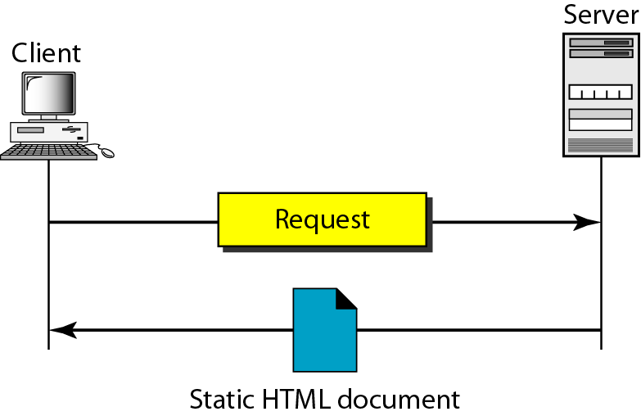
Figure 27.4 Static document
Static documents are fixed-content documents that are created and stored in a server.
Static documents are prepared using one of the several languages: Hypertext Markup Language (HTML), Extensible Markup Language (XML), Extensible
Style Language (XSL), and Extended Hypertext Markup Language (XHTML).
27.<number>

Slide 9
Dynamic Documents
A dynamic document is created by a Web server whenever a browser requests the document. When a request arrives, the Web server runs an application program or a script that creates the dynamic document.
The server returns the output of the program or script as a response to the browser that requested the document
A very simple example of a dynamic document is the retrieval of the time and date from a server.
The Common Gateway Interface (CGI) is a technology that creates and handles dynamic documents.
CGI is a set of standards that defines how a dynamic document is written, how data are input to the program, and how the output result is used.
CGI defines is a set of rules and terms that the programmer must follow.

Slide 10
Dynamic Documents : CGI
The Common Gateway Interface (CGI) is a technology that creates and handles dynamic documents.
CGI is a set of standards that defines how a dynamic document is written, how data are input to the program, and how the output result is used.
CGI defines is a set of rules and terms that the programmer must follow.
The term gateway here means that a CGI program can be used to access other resources such as databases, graphic packages, and so on.
The term interface here means that there is a set of predefined terms, variables, calls, and so on that can be used in any CGI program.
27.<number>

Slide 11
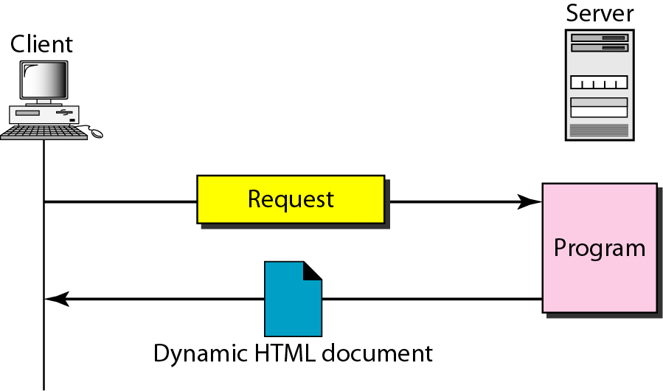
Figure 27.8 Dynamic document using CGI
27.<number>

Slide 12
Scripting Technologies for Dynamic Documents
problem with CGI technology is the inefficiency.
Solution is to create a file containing the fixed part of the document using HTML and embed a script, a source code, that can be run by the server.
Technologies involved in creating dynamic documents using scripts:
Hypertext Preprocessor (PHP),
Java Server Pages (JSP),
Active Server Pages (ASP)
ColdFusion,
27.<number>

Slide 13
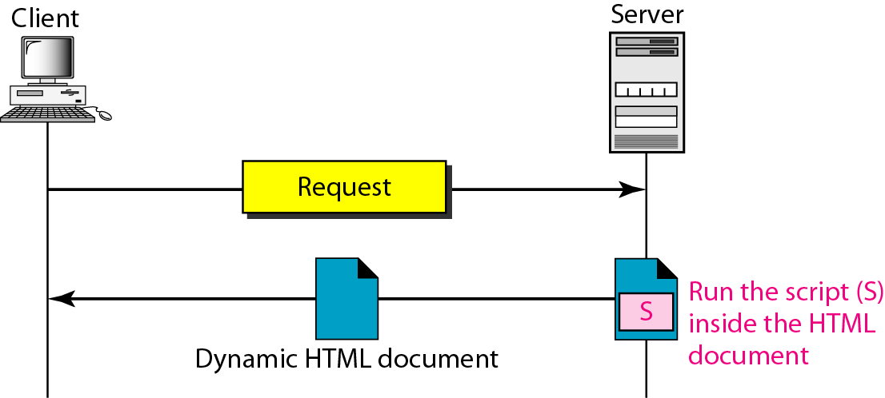
Figure 27.9 Dynamic document using server-site script
27.<number>

Slide 14

Note
Dynamic documents are sometimes referred to as server-site dynamic documents.
27.<number>

Slide 15
Active Documents
For many applications, we need a program or a script to be run at the client site. These are called active documents.
When a browser requests an active document, the server sends a copy of the document or a script. The document is then run at the client (browser) site.
27.<number>

Slide 16
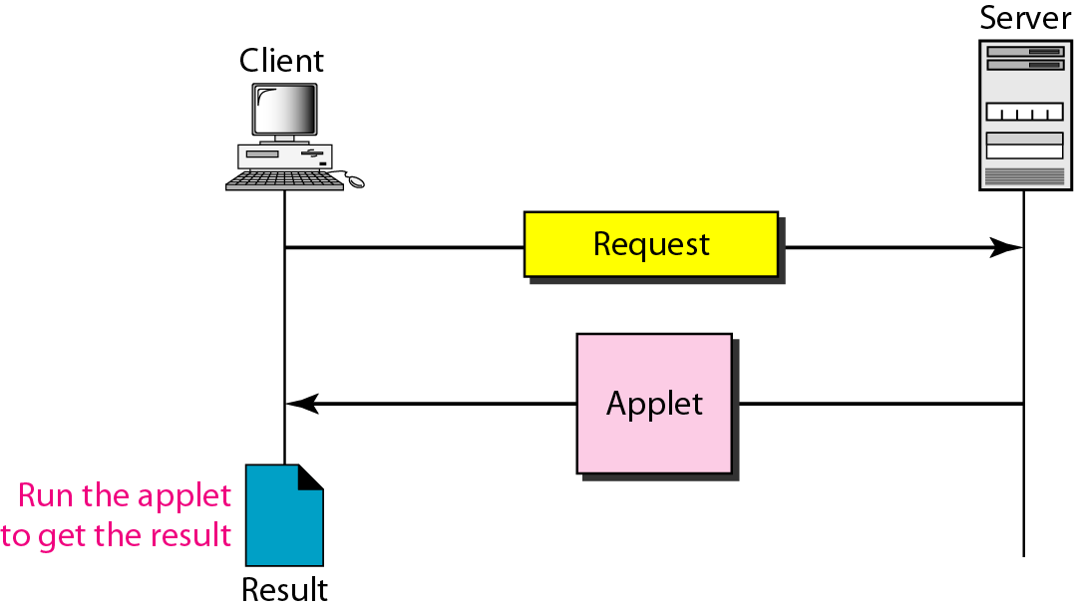
Figure 27.10 Active document using Java applet
27.<number>

Slide 17
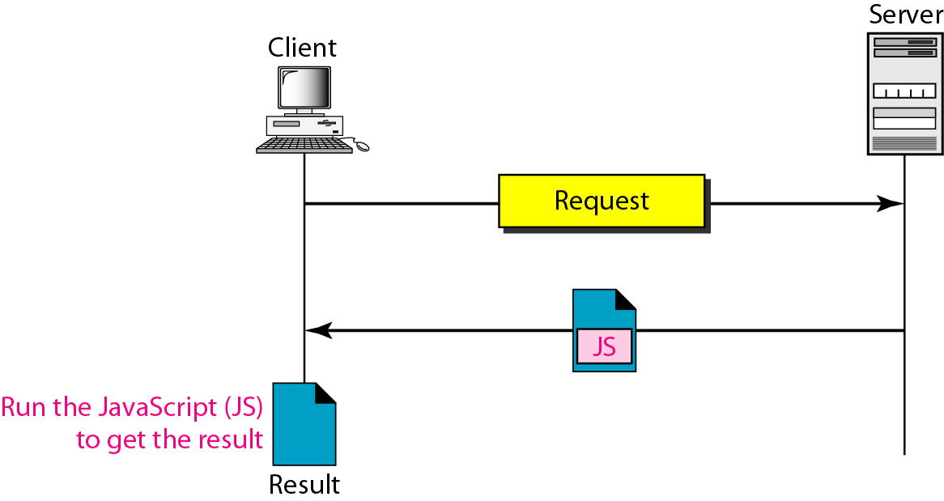
Figure 27.11 Active document using client-site script
27.<number>

Slide 18
Note
Active documents are sometimes referred to as client-site dynamic documents.
27.<number>

Slide 19
27-3 HTTP
The Hypertext Transfer Protocol (HTTP) is a protocol used mainly to access data on the World Wide Web. HTTP functions as a combination of FTP and SMTP.
It is similar to FTP because it transfers files and uses the services of TCP.
HTTP is like SMTP because the data transferred between the client and the server look like SMTP messages.
27.<number>

Slide 20
Note
HTTP uses the services of TCP on well-known port 80.
27.<number>

Slide 21
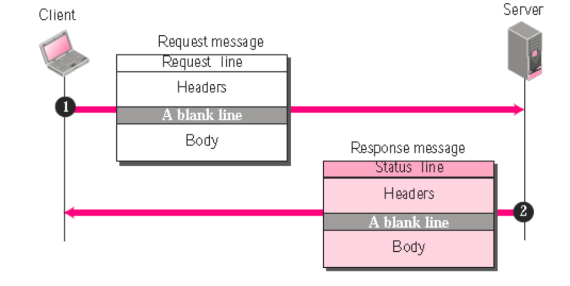
Figure 27.12 HTTP transaction
27.<number>

Slide 22
HTTP Transaction
HTTP uses the services of TCP, HTTP itself is a stateless protocol, which means that the server does not keep information about the client.
The client initializes the transaction by sending a request. The server replies by sending a response.

Slide 23
Request Message
A request message consists of a request line, a header, and sometimes a body.
Request Line: The first line in a request message is called a request line. There are three fields in this line separated by some character delimiter. The fields are called methods, URL, and Version.
These three should be separated by a space character.
At the end two characters, a carriage return followed by a line feed, terminate the line.
The method field defines the request type.

Slide 24
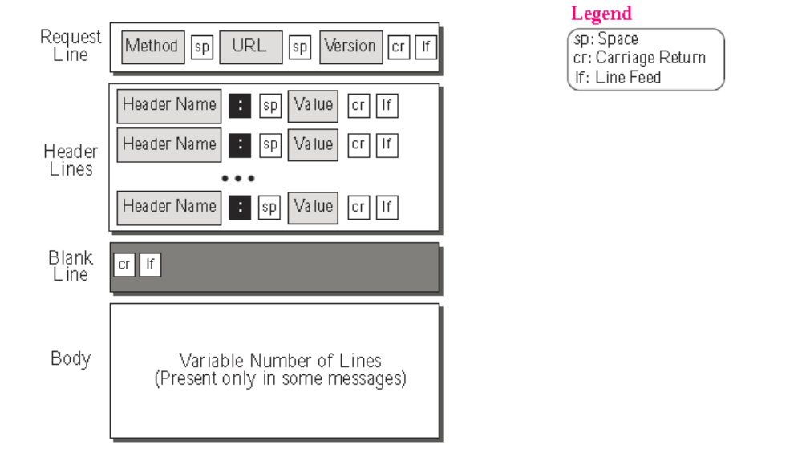
Format of request message:

Slide 25
Request Message (cont.)
The second field, URL, It defines the address
and name of corresponding Web page. The third field, version, gives the version of the protocol; the most current version of HTTP is 1.1.
Header Lines In Request Message
After the request line, we can have zero or more request header lines. Each header line sends additional information from the client to the server.
Each header line has a header name, a colon, a space, and a header value
The value field defines the values associated with each header name.
Body In Request Message The body can be present in a request message. Usually, it contains the comment to be sent.

Slide 26
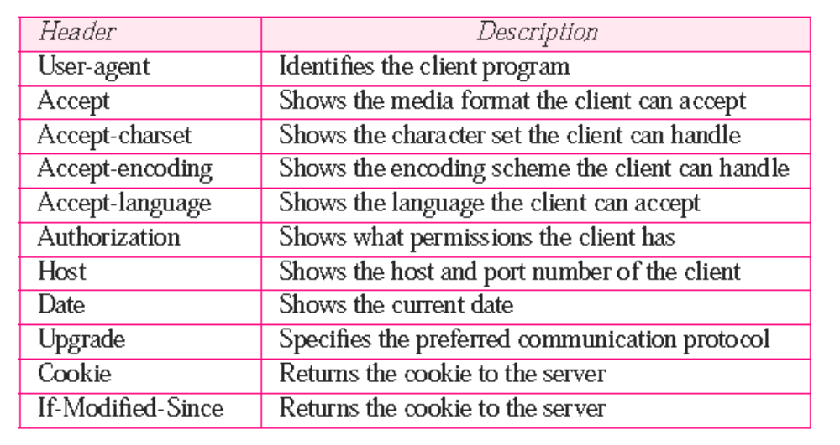
Request Header Names
27.<number>

Slide 27
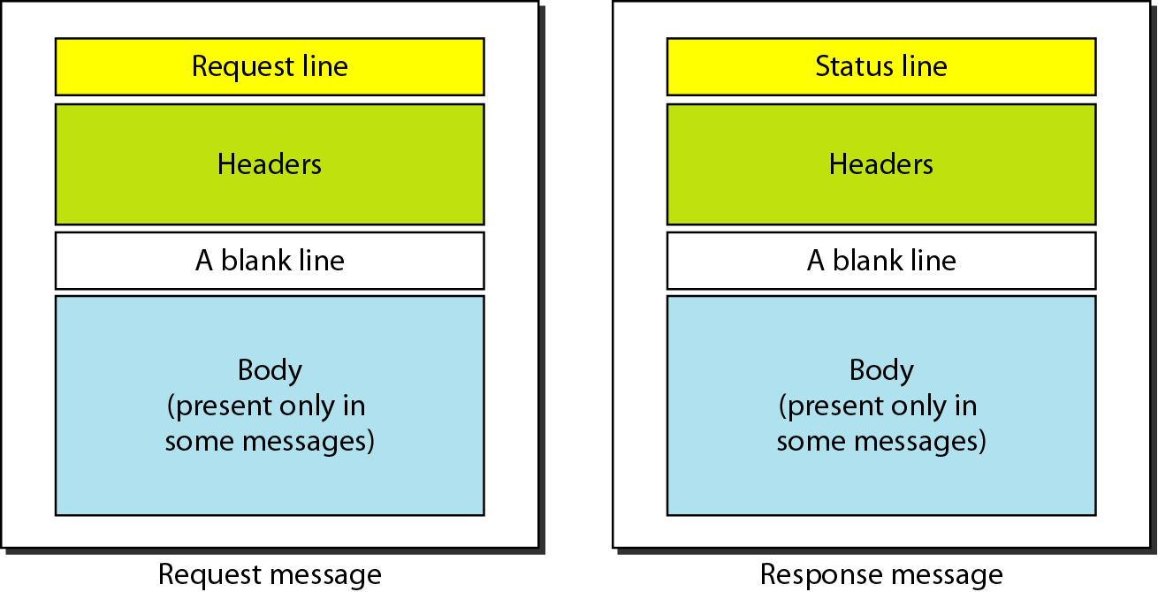
Figure 27.13 Request and response messages
27.<number>

Slide 28
Response Message
A response message consists of a status line, header lines, a blank line and sometimes a body.
Status Line
The first line in a response message is called the status line.
There are three fields in this line separated by spaces and terminated by a carriage return and line feed.
The first field defines the version of HTTP protocol, currently 1.1.
The status code field defines the status of the request. It consists of three digits.
27.<number>

Slide 29
Header Lines In Response Message
After the status line, we can have zero or more response header lines.
Each header line sends additional information from the server to the client.
For example, the sender can send extra information about the document.
Each header line has a header name, a colon, a space, and a header value
Body
The body contains the document to be sent from the server to the client. The body is present unless the response is an error message.

Slide 30
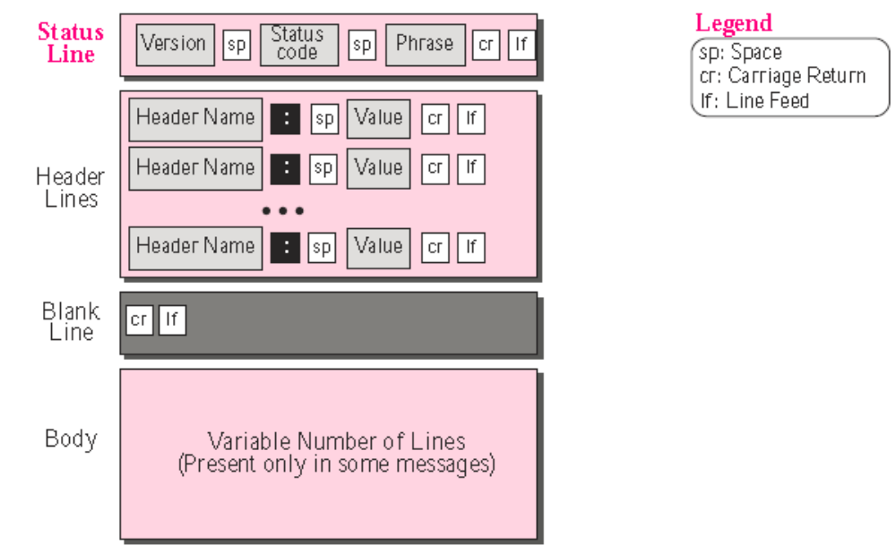
Format of the response message
27.<number>

Slide 31
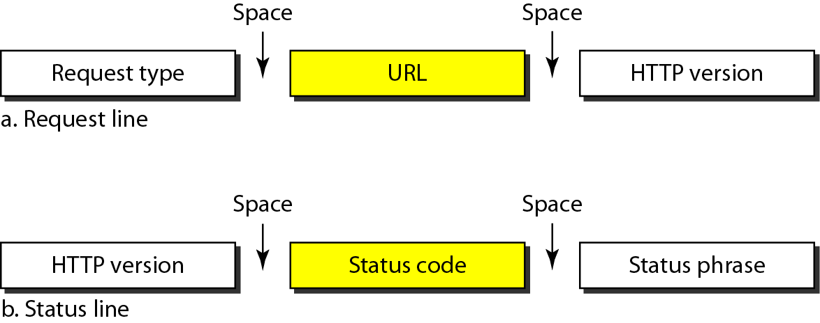
Figure 27.14 Request and status lines
27.<number>

Slide 32
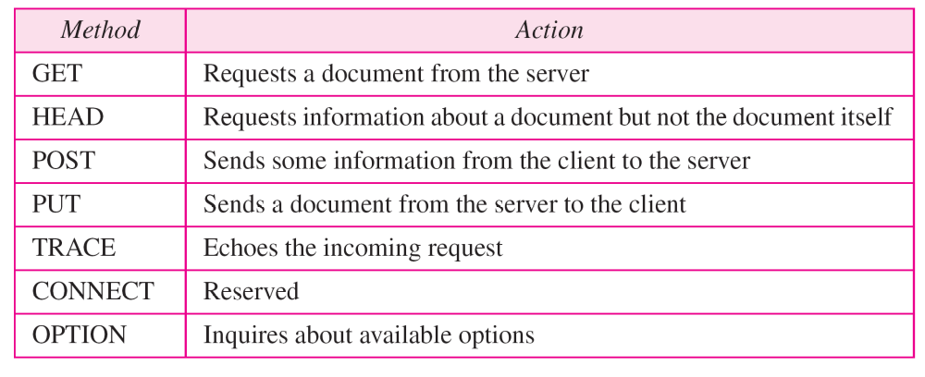
In version 1.1 of HTTP, several methods are defined, as shown in Table below
Table 27.1 Methods
27.<number>

Slide 33
Table 27.2 Status codes
27.<number>

Slide 34
Table 27.2 Status codes (continued)
27.<number>

Slide 35
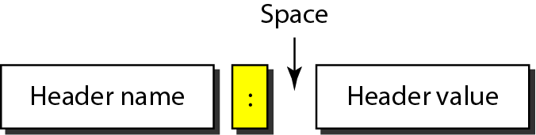
Figure 27.15 Header format
27.<number>

Slide 36
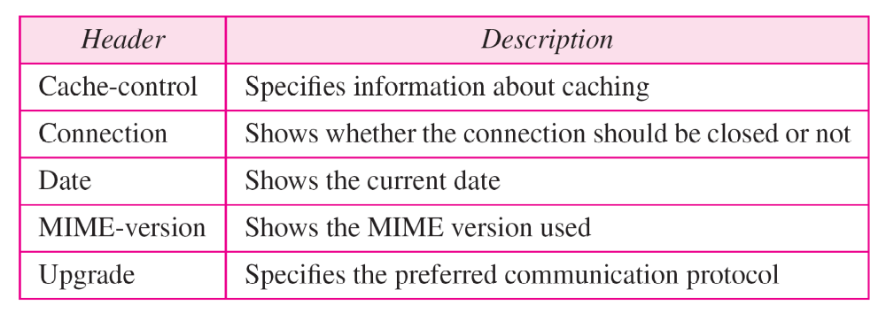
Table 27.3 General headers
27.<number>

Slide 37
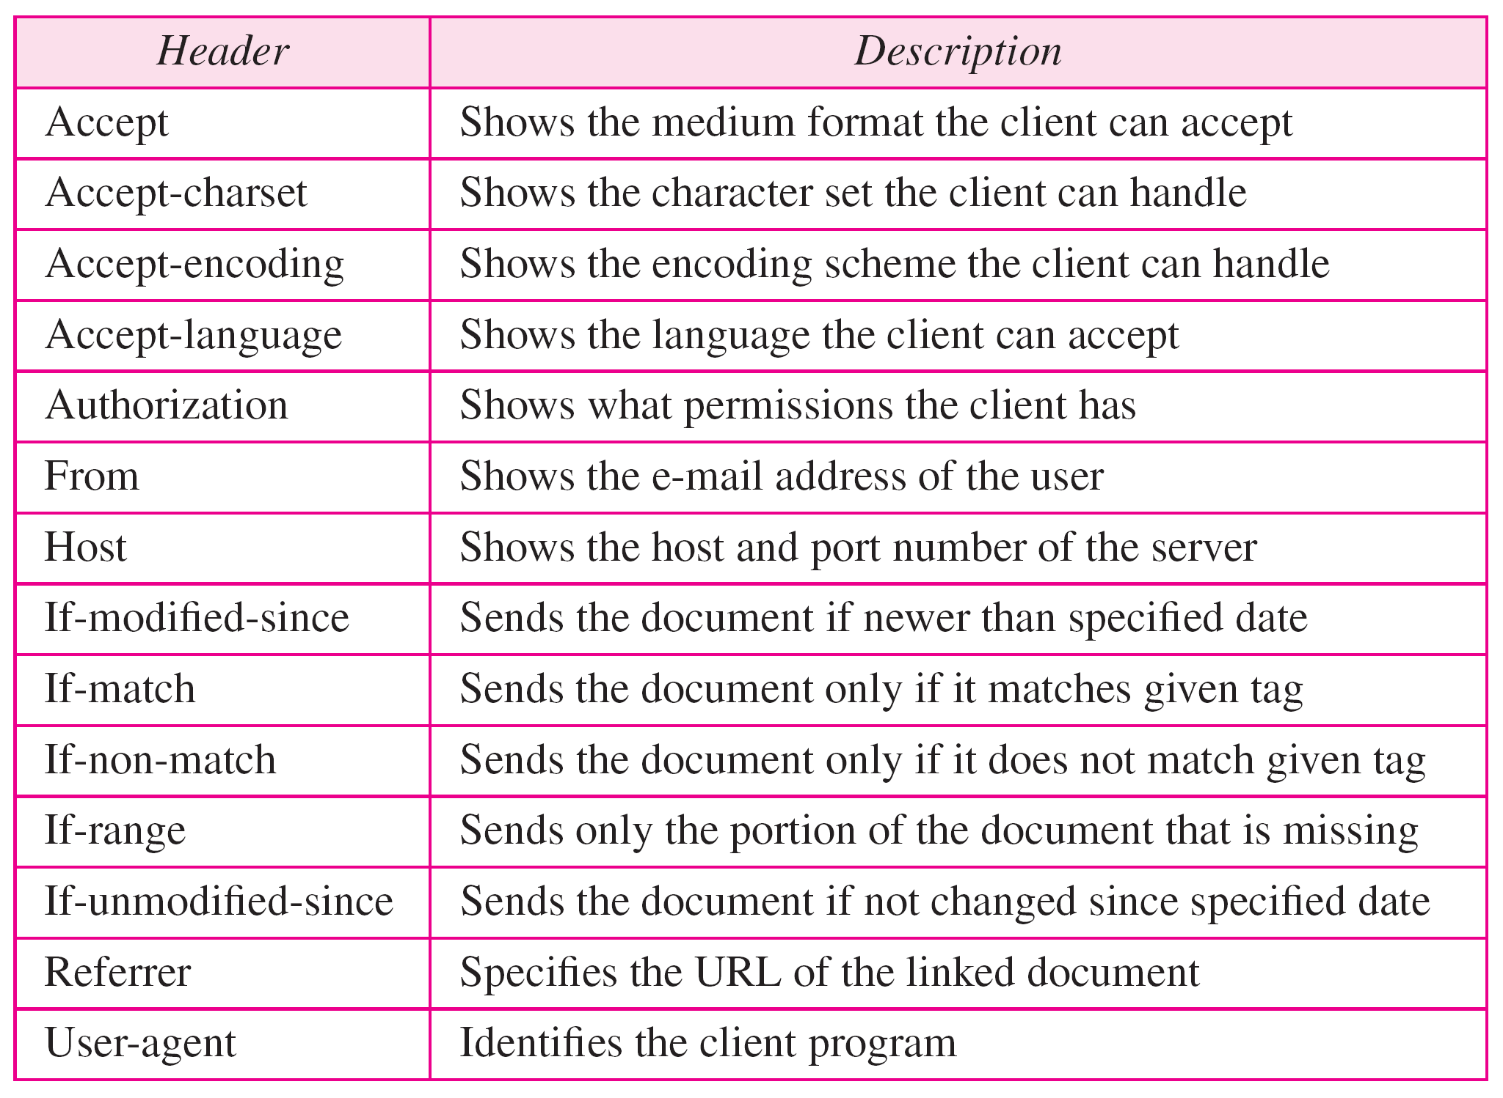
Table 27.4 Request headers
27.<number>

Slide 38
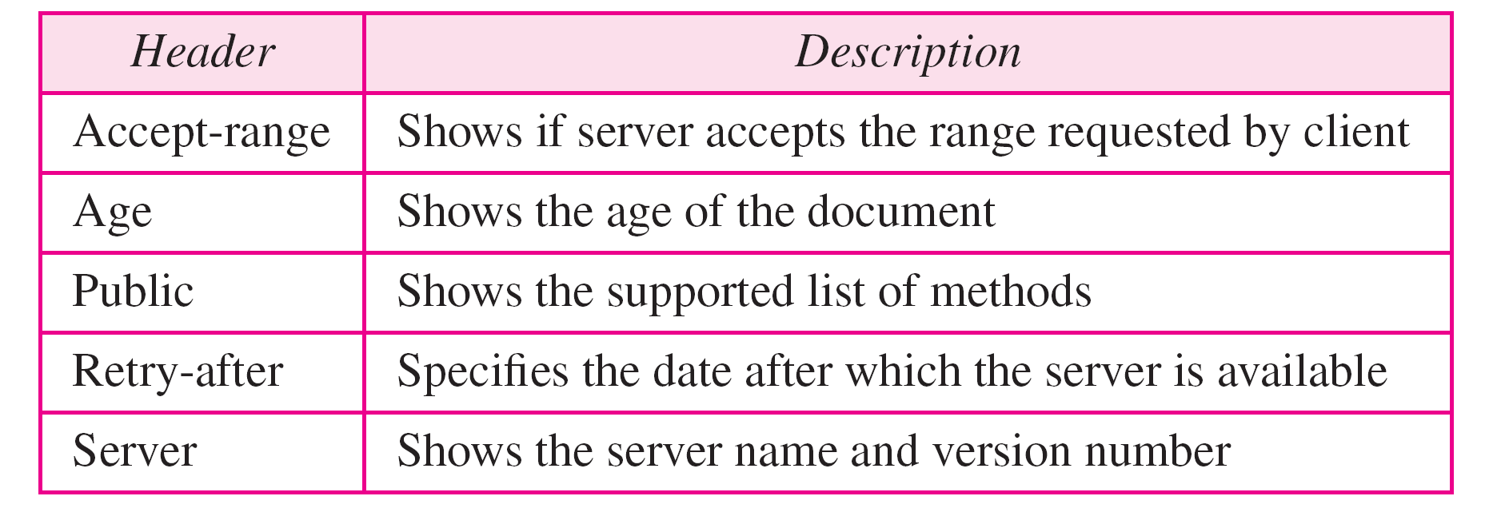
Table 27.5 Response headers
27.<number>

Slide 39
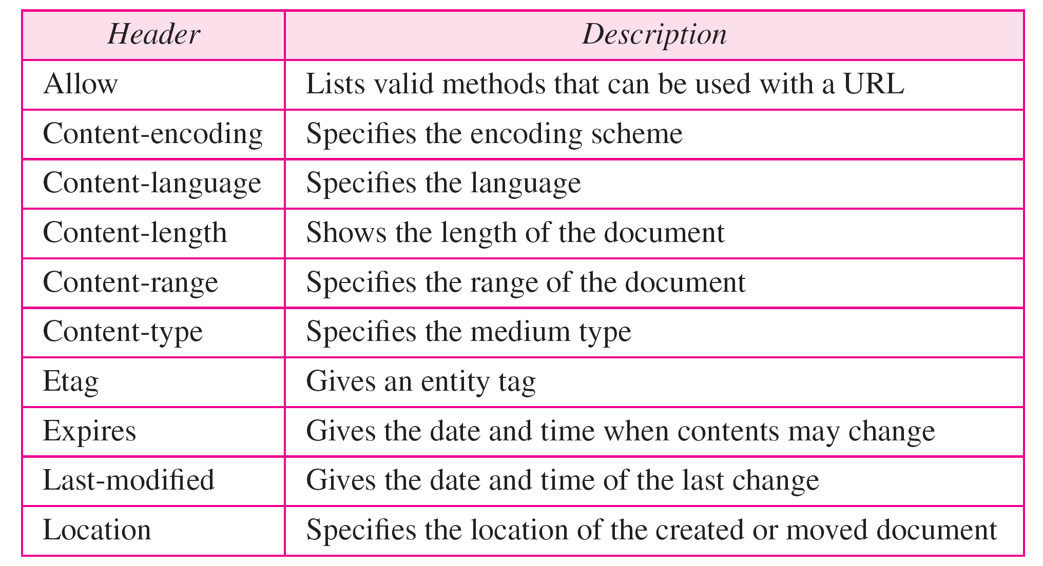
Table 27.6 Entity headers
27.<number>

Slide 40
Example 27.1
This example retrieves a document. We use the GET method to retrieve an image with the path /usr/bin/image1. The request line shows the method (GET), the URL, and the HTTP version (1.1). The header has two lines that show that the client can accept images in the GIF or JPEG format. The request does not have a body. The response message contains the status line and four lines of header. The header lines define the date, server, MIME version, and length of the document. The body of the document follows the header (see Figure 27.16).
27.<number>

Slide 41
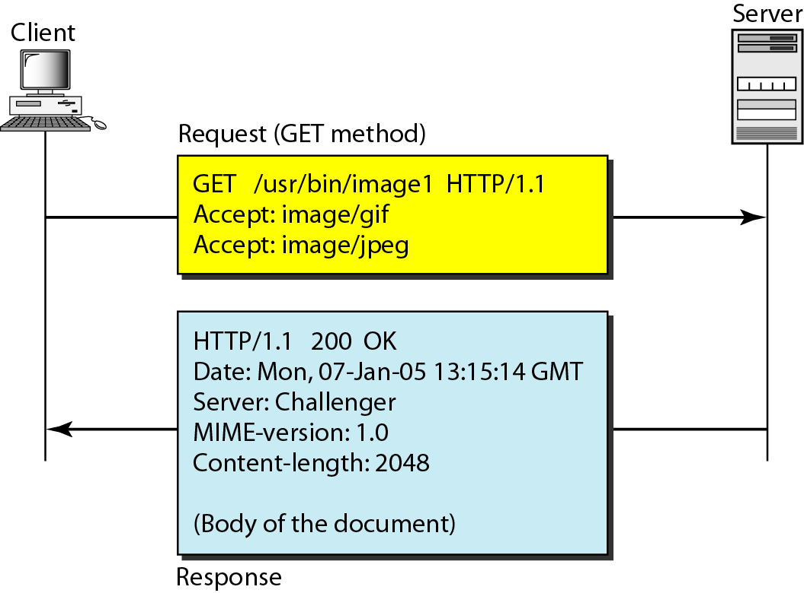
Figure 27.16 Example 27.1
27.<number>

Slide 42
Example 27.2
In this example, the client wants to send data to the server. We use the POST method. The request line shows the method (POST), URL, and HTTP version (1.1). There are four lines of headers. The request body contains the input information. The response message contains the status line and four lines of headers. The created document, which is a CGI document, is included as the body (see Figure 27.17).
27.<number>

Slide 43
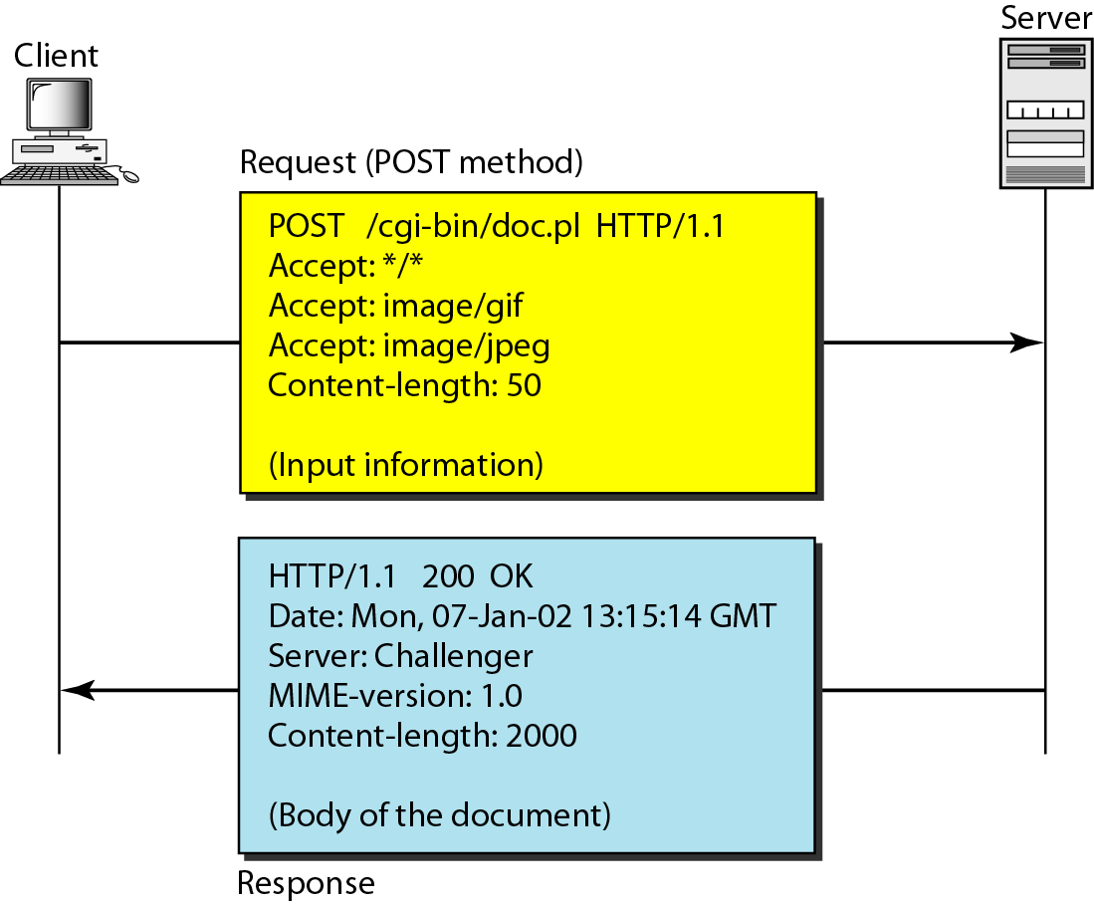
Figure 27.17 Example 27.2
27.<number>

Slide 44
Example 27.3
HTTP uses ASCII characters. A client can directly connect to a server using TELNET, which logs into port 80 (see next slide). The next three lines show that the connection is successful. We then type three lines. The first shows the request line (GET method), the second is the header (defining the host), the third is a blank, terminating the request. The server response is seven lines starting with the status line. The blank line at the end terminates the server response. The file of 14,230 lines is received after the blank line (not shown here). The last line is the output by the client.
27.<number>

Slide 45
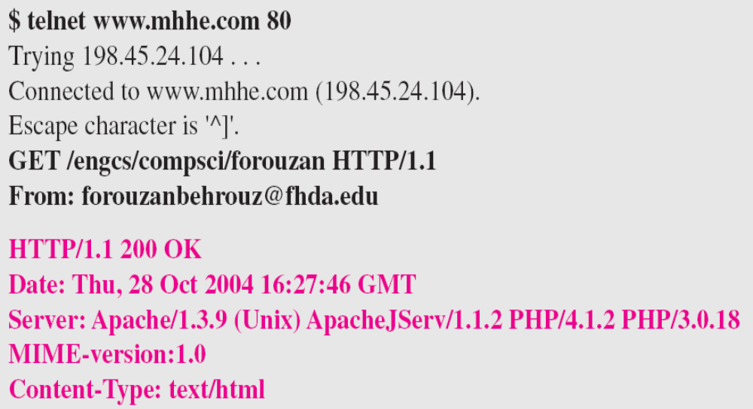
Example 27.3 (continued)
27.<number>

Slide 46
Persistence
HTTP, prior to version 1.1, specified a non-persistent connection, while a persistent connection is the default in version 1.1.
Non-persistent Connection
In a non-persistent connection, one TCP connection is made for each request/response.
The following lists the steps in this strategy:
1. The client opens a TCP connection and sends a request.
2. The server sends the response and closes the connection.
3. The client reads the data until it encounters an end-of-file marker; it then closes the connection.

Slide 47
Persistent Connection
HTTP version 1.1 specifies a persistent connection by default.
In a persistent connection, the server leaves the connection open for more requests after sending a response.
The server can close the connection at the request of a client or if a time-out has been reached.
The sender usually sends the length of the data with each response.
27.<number>

Slide 48
Note
HTTP version 1.1 specifies a persistent connection by default.
27.<number>

